Slide 1
Real-time Segmentation and Recognition of On-line Handwritten Arabic Script
By George Kour
Supervised By:
Prof. Dana Ron
Dr. Raid Saabne
Masters Thesis Defense
16 November, 2014

Slide 2
Agenda
Problem Statement
Motivation
Characteristics of the Arabic Script
Solution Outline
Real-time Segmentation
Fast Letter Classification
Demo
Future Work

Slide 3
Problem Statement
Correct and efficient recognition of handwritten Arabic text is challenging problem due to the cursive and unconstrained nature of the Arabic script.
Thus,
Conventional approaches of online Handwriting recognition usually wait until the entire curve is traced out before starting the analysis.
However,
This delays the recognition process, and,
Prevents implementing advanced features of input typing, such as automatic word completion.

Slide 4
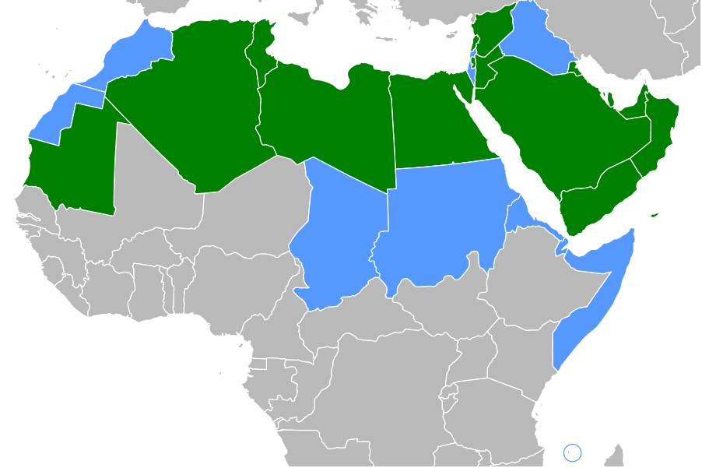
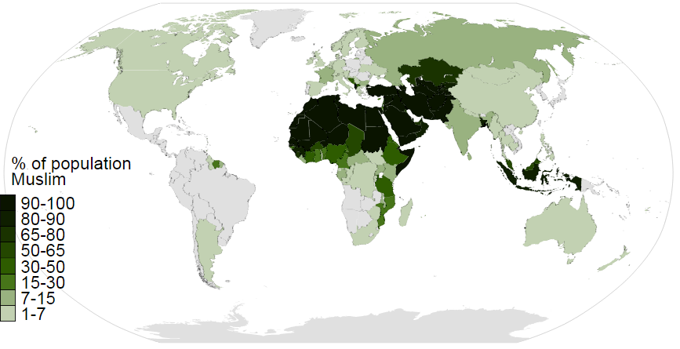
Motivation

Slide 5


Motivation

Slide 6
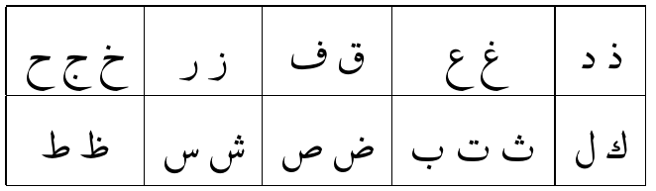


Characteristics of the Arabic Language
Iso | Ini | Mid | Fin
ع | عـ | ـعـ | ـع
ه | هـ | ـهـ | ـه
ًٌٍَُِّْ
4 shapes letters
Rasm (رسم)and i’jam (إعجام)
Harakat (حركات)
اَلْعَرَبِيّةُ
العربية
Fully vocalized script
Segmentation Points (SPs) and Baseline
Words Parts (WPs) and Strokes

Slide 7
Solution Outline
Real-time recognition of Arabic Handwritten script.
i.e., performing analysis tasks during the course of writing.
How do we do that?
Continuous points of interest (POIs) nomination while scribing a stroke.
Attach scoring to the resulting sub-strokes.
Selecting the best set of segmentation points.
This requires:
Real time POIs nomination algorithm.
Fast letter classifier.
Segmentation points filtering and selection algorithms.

Slide 8
Real-time Segmentation of On-line Handwritten Arabic Script
14th International Conference on Frontiers in Handwriting Recognition (ICFHR 2014)

Slide 9
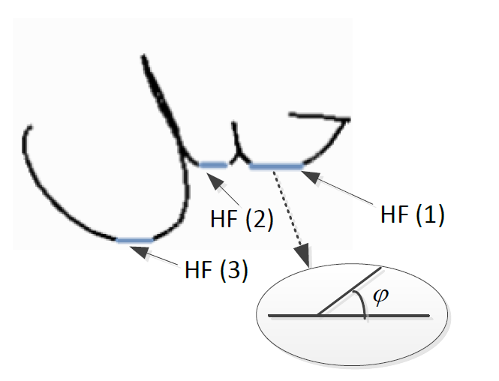
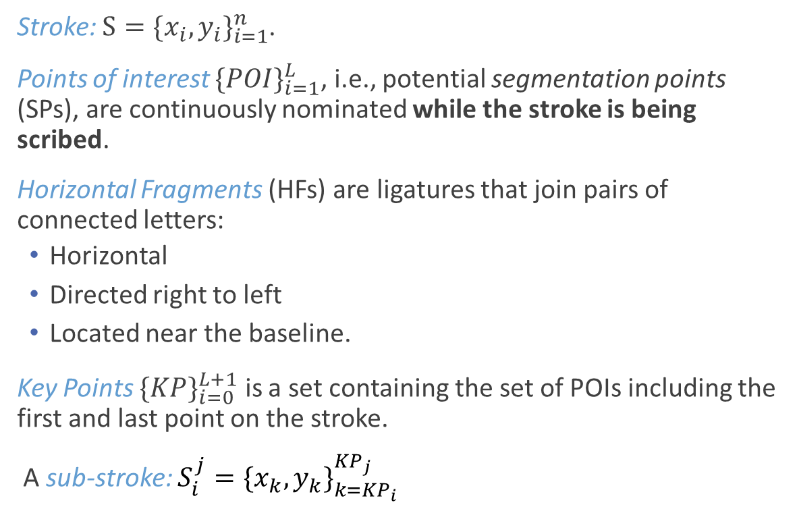
Definitions
Stroke: $S={\{x_{i},y_{i}\}}_{i=1}^{n}$.
Points of interest ${\{POI\}}_{i=1}^{L}$, i.e., potential segmentation points (SPs), are continuously nominated while the stroke is being scribed.
Horizontal Fragments (HFs) are ligatures that join pairs of connected letters:
Horizontal
Directed right to left
Located near the baseline.
Key Points ${\{KP\}}_{i=0}^{L+1}$ is a set containing the set of POIs including the first and last point on the stroke.
A sub-stroke: $S_{i}^{j}={\{x_{k},y_{k}\}}_{k=KP_{i}}^{KP_{j}}$

Slide 10
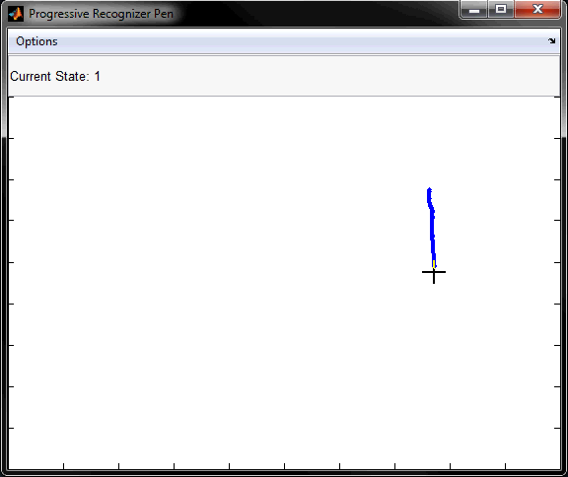
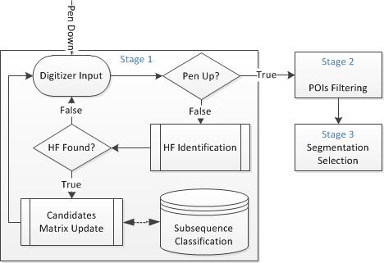
Stage 1 - HF Identification

Slide 11
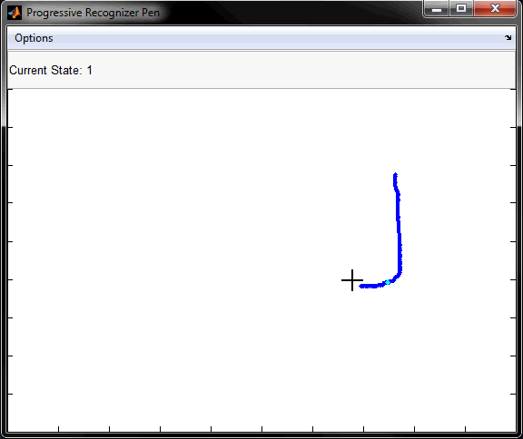
Stage 1 - HF Identification

Slide 12

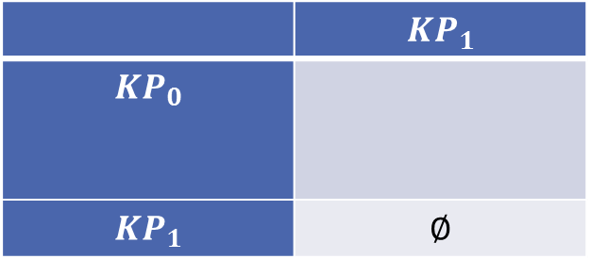
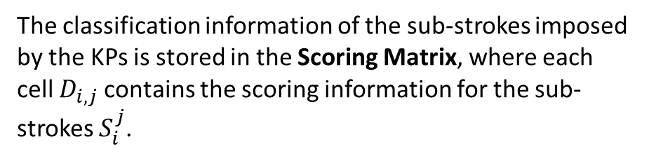
Stage 1 – Sub-strokes Scoring
The classification information of the sub-strokes imposed by the KPs is stored in the Scoring Matrix, where each cell $D_{i,j}$contains the scoring information for the sub-strokes $S_{i}^{j}$.
 | $$KP_{1}$$
$$KP_{0}$$
$$KP_{1}$$ | $$∅$$

Slide 13
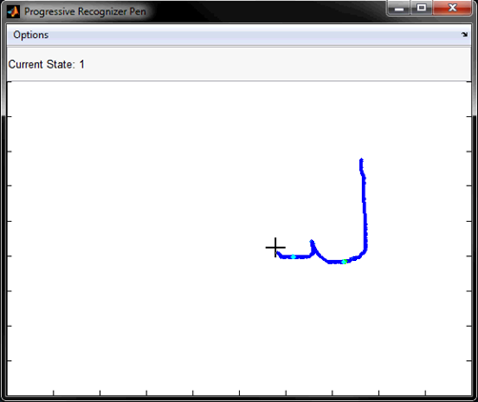


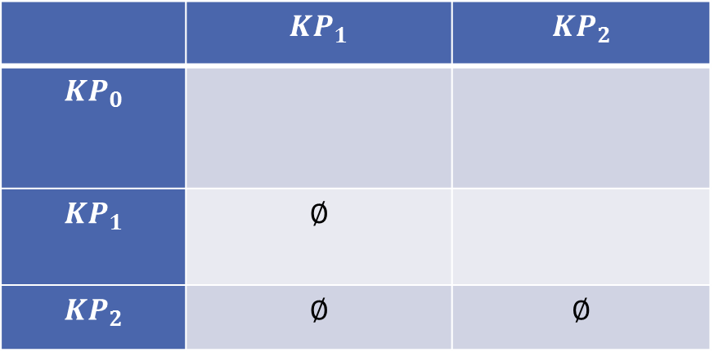
Stage 1 – Sub-strokes Scoring
 | $$KP_{1}$$ | $$KP_{2}$$
$$KP_{0}$$
$$KP_{1}$$ | $$∅$$
$$KP_{2}$$ | $$∅$$ | $$∅$$

Slide 14
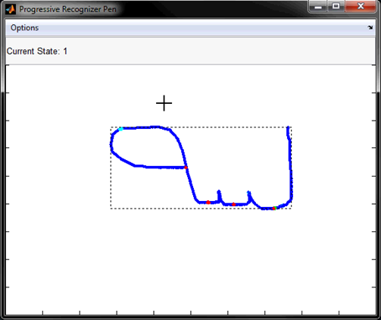
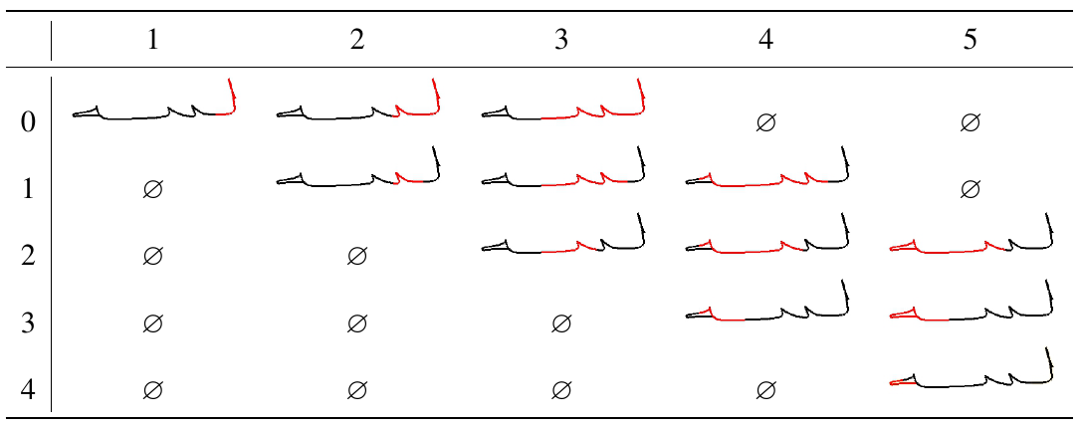
Stage 1 – Sub-strokes Scoring

Slide 15
Stage 2 – POIs Filtering
Once the entire stroke is available, a rules-based process is used to refine the set of POIs and re-score the sub-strokes based on the following rules:
SPs should lie close to the baseline.
do not reside in loops.
sub-stroke length should be proportional to the length of the containing stroke.

Slide 16
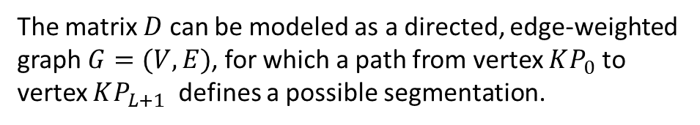
Stage 3 – Segmentation Selection
The matrix $D$ can be modeled as a directed, edge-weighted graph $G=(V,E)$, for which a path from vertex $KP_{0}$ to vertex $KP_{L+1}$ defines a possible segmentation.

Slide 17
Results
Over-segmentation:
A horizontal region in initial form which does not accommodate a SP.
A letter spanned over several strokes.
Under-segmentation:
Letter pairs that are not separated by HFs (e.g., لم and لح).
Not selecting a POI in the third stage.
City name Samples | 319
Num. of Strokes | 1237
Segmentation Rate | 83%
Recognition Rate [Top 3] | 78%*

Slide 18
Recent Work
Work | Results | Dataset
(Randa et al., 2012) | 51% (SR) | OHASD - a self collected dataset that includes 154 paragraphs (more than 3800 words) written by 48 writers.
(Daifallah et al., 2009) | 79% (RR) | Self collected database contained 150 words.

Slide 19
Fast Classification of Handwritten On-line Arabic Characters
6th international conference of soft computing and pattern recognition (SOCPAR 2014)

Slide 20
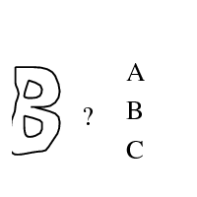
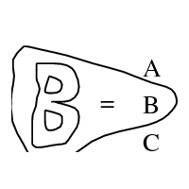

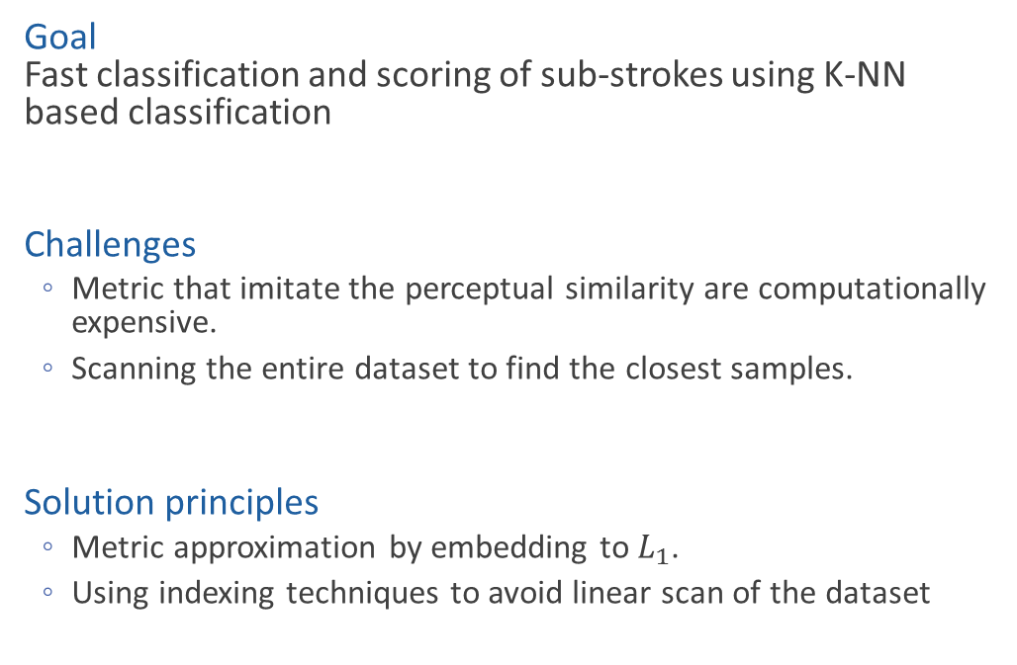
Outline
Goal Fast classification and scoring of sub-strokes using K-NN based classification
Challenges
Metric that imitate the perceptual similarity are computationally expensive.
Scanning the entire dataset to find the closest samples.
Solution principles
Metric approximation by embedding to $L_{1}$.
Using indexing techniques to avoid linear scan of the dataset

Slide 21
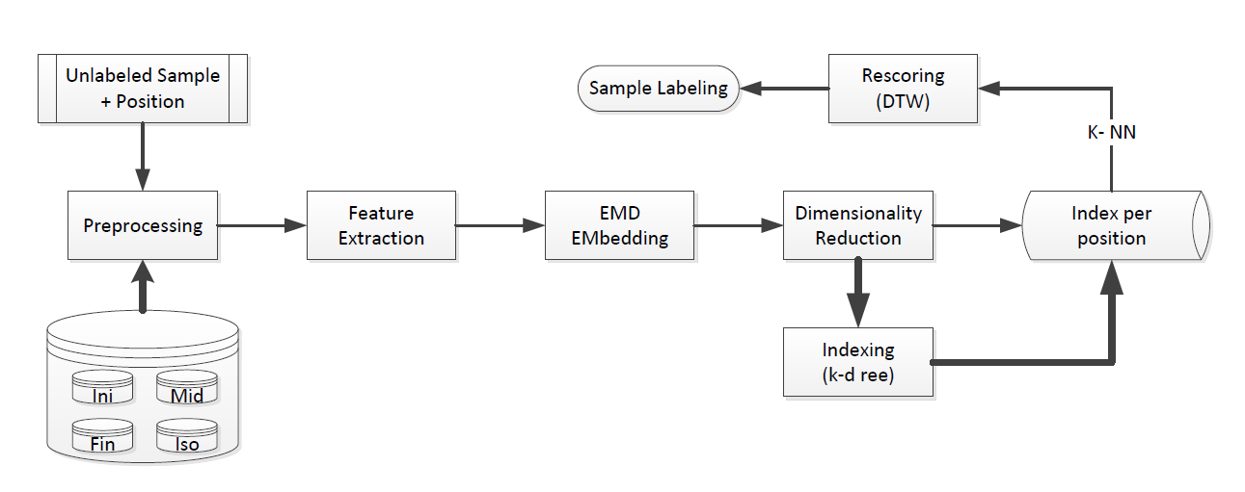
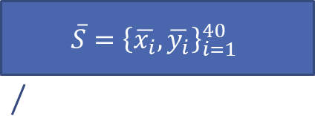
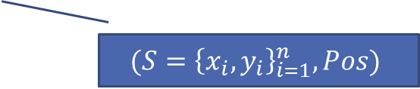
Preprocessing
$$\overline{S}={\left\{\overline{x_{i}},\overline{y_{i}}\right\}}_{i=1}^{40}$$
$$(S={\left\{x_{i},y_{i}\right\}}_{i=1}^{n},Pos)$$

Slide 22
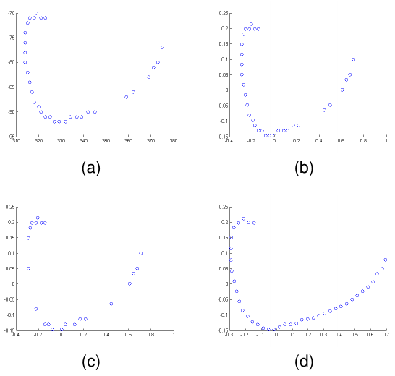
Preprocessing
Give a uniform structure to the data by avoiding:
Jagged and non-uniform sampling of the digitizer
Imperfections caused by hand vibration from hesitate writing.
Normalization: Uniform size bound box surrounding the pattern.
Noise elimination: using the Douglas-Peucker algorithm.
Re-sampling: using quadratic piecewise interpolation function.

Slide 23
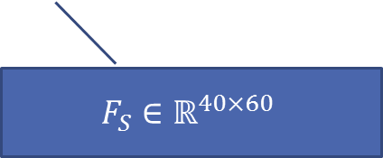
Feature Extraction
$$\overline{S}={\left\{\overline{x_{i}},\overline{y_{i}}\right\}}_{i=1}^{40}$$
$$F_{S}∈ℝ^{40×60}$$

Slide 24
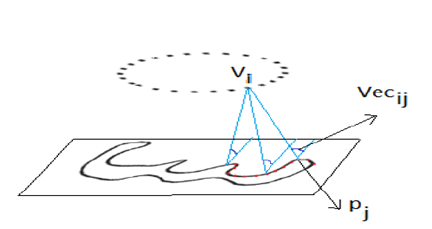
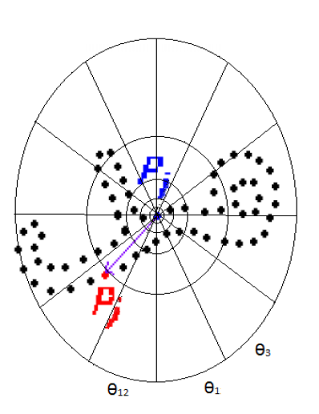
Feature Extraction
Feature extraction is the process of extracting informative parameters for learning and recognition of patterns.
Multi Angular Descriptor (MAD)
(Saabni, 2013)
Shape Context (SC) (Belongie, et al. 2002)

Slide 25
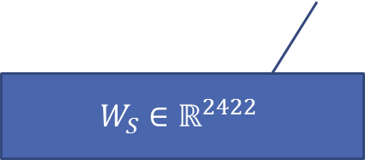
EMD Embedding
$$F_{S}∈ℝ^{40×60}$$
$$W_{S}∈ℝ^{2422}$$

Slide 26
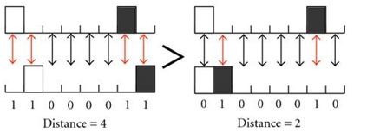
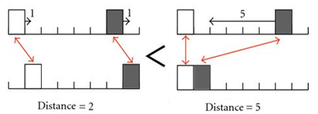
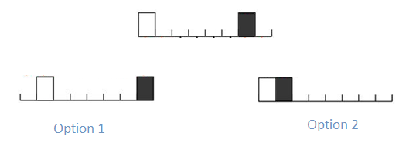
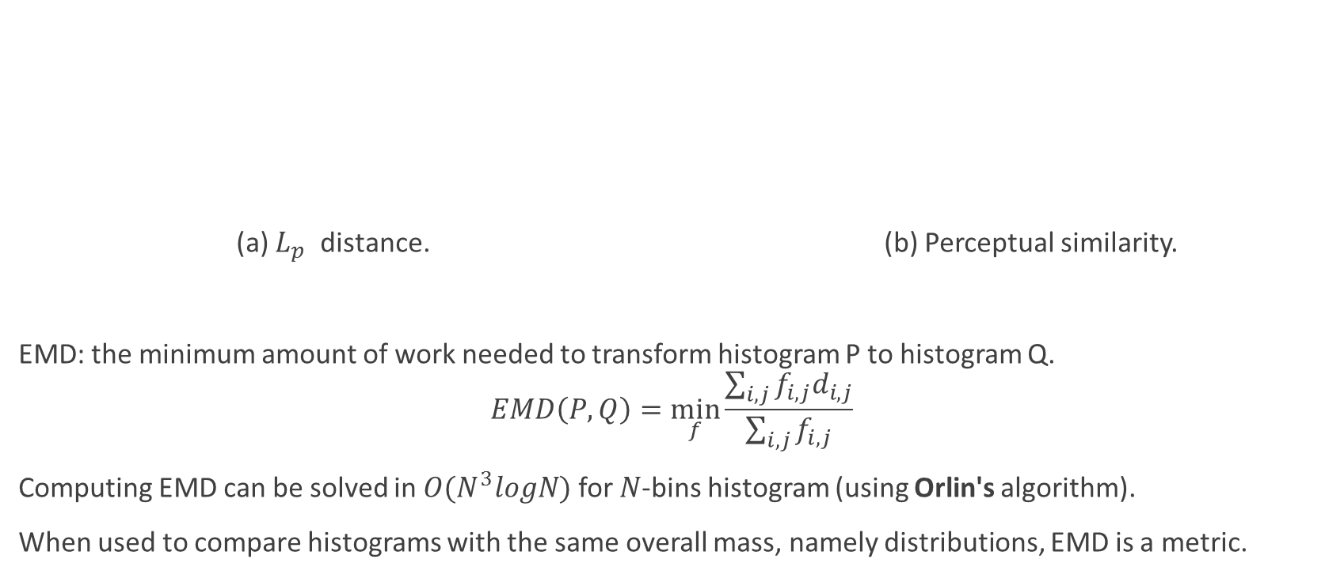
Earth Movers Distance (EMD)
(a) $L_{p}$ distance. (b) Perceptual similarity.
EMD: the minimum amount of work needed to transform histogram P to histogram Q.
$$EMD\left(P,Q\right)=\min_{f}{\frac{\sum_{i,j}{f_{i,j}d_{i,j}}}{\sum_{i,j}{f_{i,j}}}}$$
Computing EMD can be solved in ${O(N}^{3}logN)$ for $N$-bins histogram (using Orlin's algorithm).
When used to compare histograms with the same overall mass, namely distributions, EMD is a metric.

Slide 27
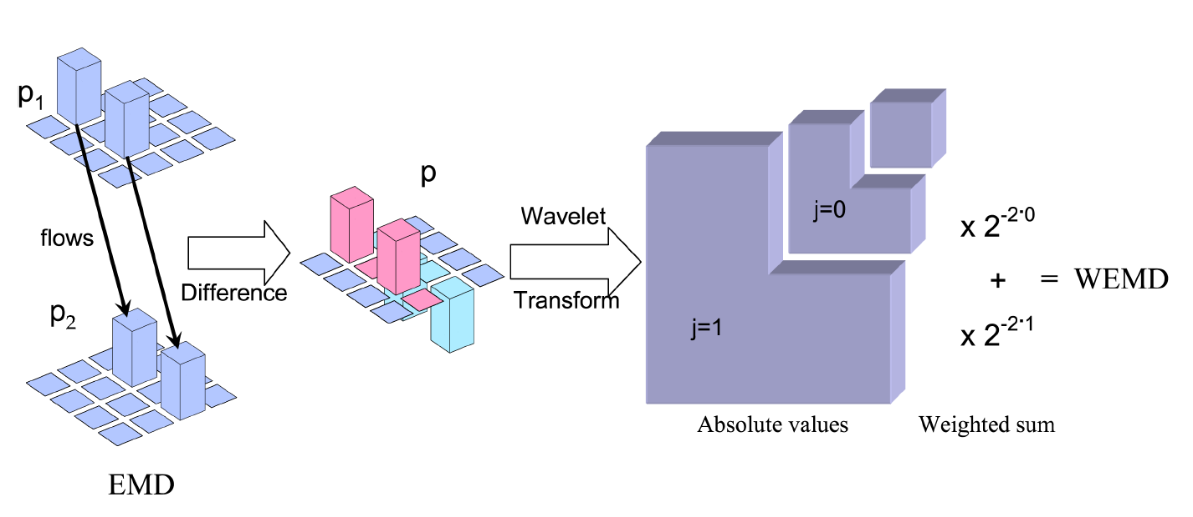
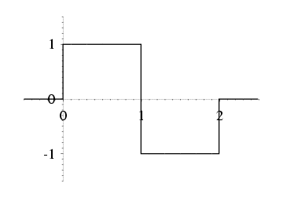
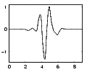
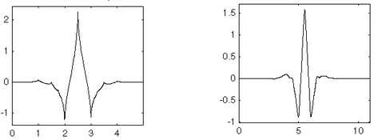
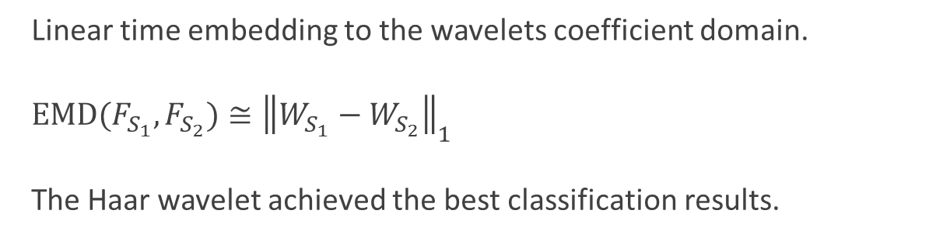
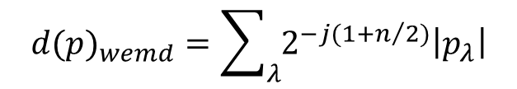
Fast EMD Approximation
Linear time embedding to the wavelets coefficient domain.
$EMD(F_{S_{1}},F_{S_{2}})≅{\left\|W_{S_{1}}−W_{S_{2}}\right\|}_{1}$
The Haar wavelet achieved the best classification results.
(Shirdhonkar and Jacobs, 2008)
$${d(p)}_{wemd}=\sum_{λ}{2^{−j(1+n/2)}\left|p_{λ}\right|}$$

Slide 28

Dimensionality Reduction
$$W_{S}∈ℝ^{2422}$$
$${RW}_{S}∈ℝ^{<10}$$

Slide 29
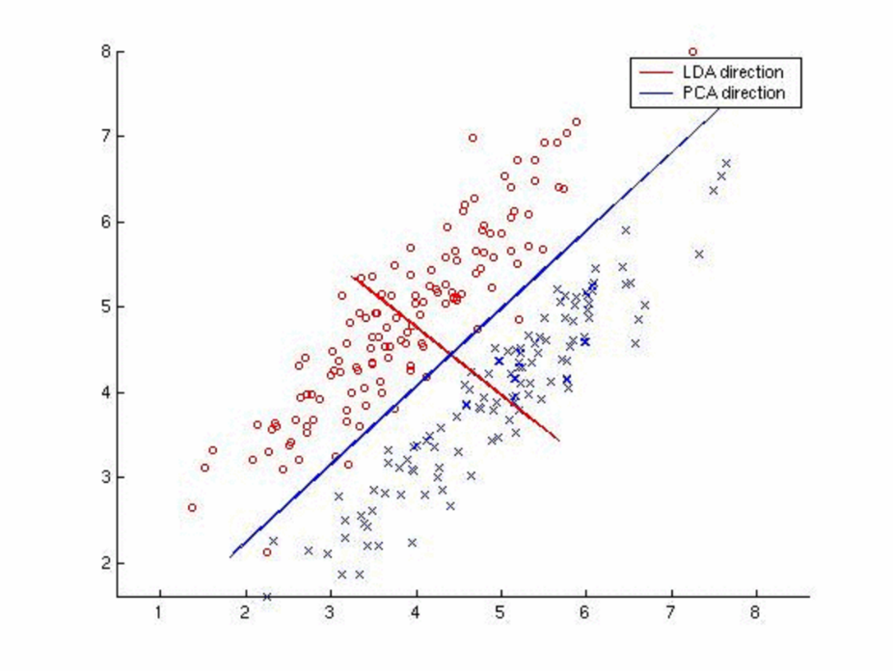
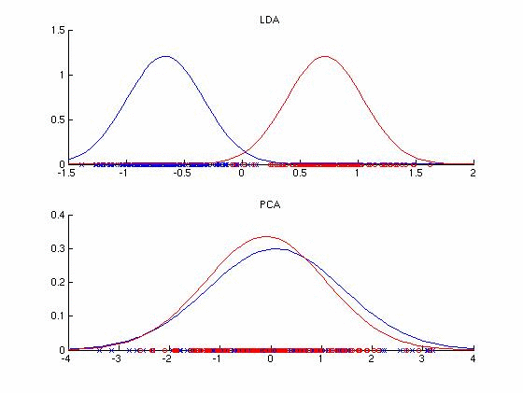
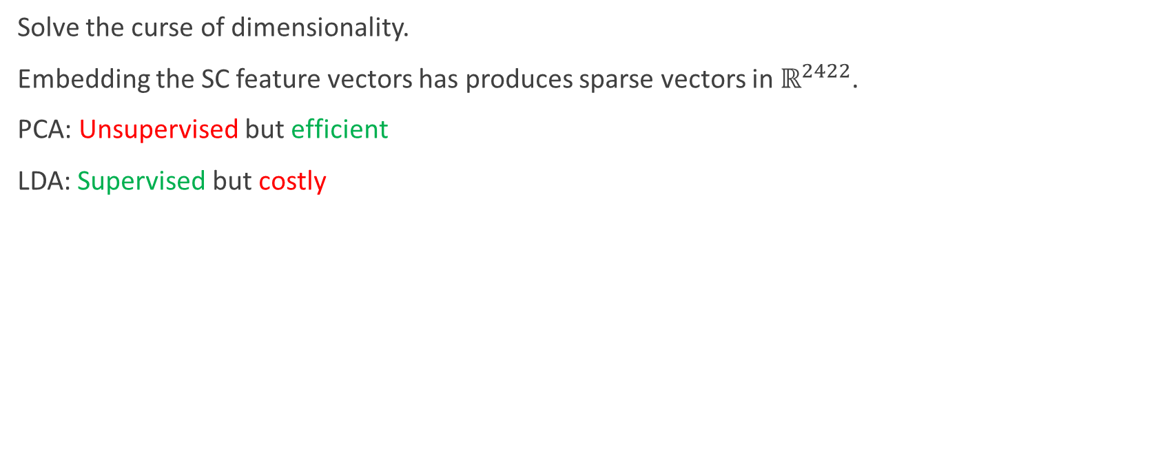
Dimensionality Reduction
Solve the curse of dimensionality.
Embedding the SC feature vectors has produces sparse vectors in $ℝ^{2422}$.
PCA: Unsupervised but efficient
LDA: Supervised but costly

Slide 30
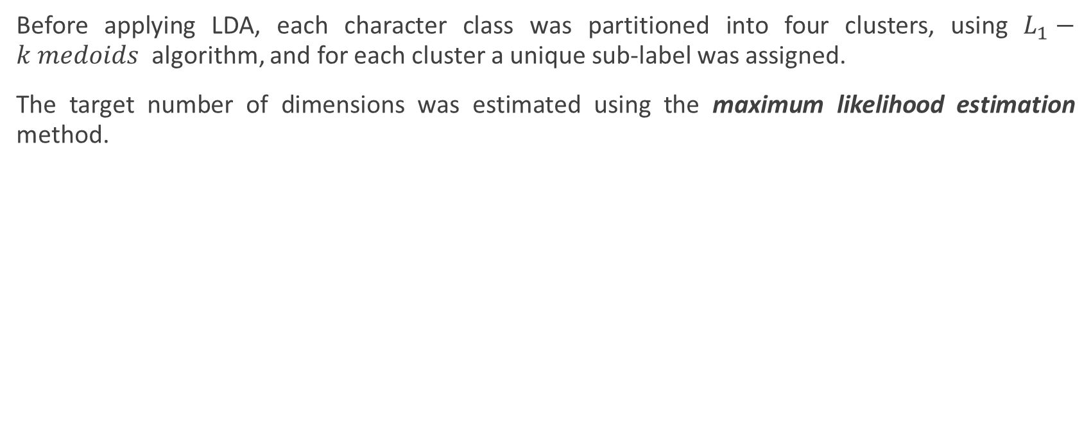
Dimensionality Reduction
Before applying LDA, each character class was partitioned into four clusters, using $L_{1}−k medoids$ algorithm, and for each cluster a unique sub-label was assigned.
The target number of dimensions was estimated using the maximum likelihood estimation method.
PCA+LDA | PCA | Letter Position
9 | 48 | Ini
10 | 52 | Mid
9 | 44 | Fin
8 | 39 | Iso

Slide 31
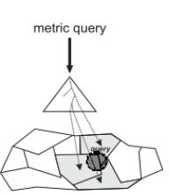
Metric Indexing
$${RW}_{S}∈ℝ^{<10}$$

Slide 32
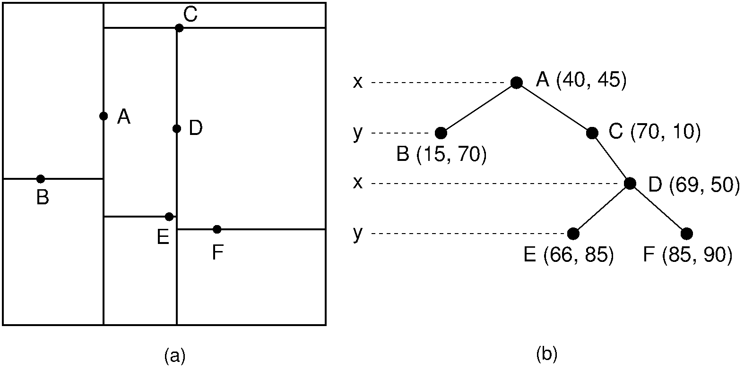
Metric Indexing
Distance function approximation techniques alone cannot avoid linear scan of the entire dataset.
The k-d tree is an efficient data structure for storing a finite set of points from a k-dimensional space.
The $k$-d tree decomposition of a region containing six data points.
The $k$-d tree representation for (a).

Slide 33


Classification Flow
$$C_{1}…C_{k}$$
$$(S={\left\{x_{i},y_{i}\right\}}_{i=1}^{n},Pos)$$

Slide 34
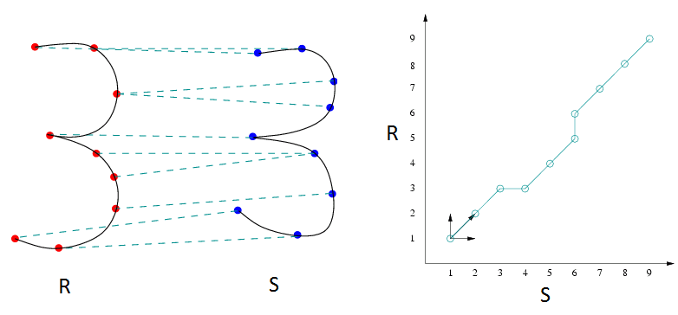
Candidates Rescoring using DTW
Re-scoring of the candidates is done by calculating the DTW distance between the preprocessed version of the query sequence and the candidates.

Slide 35
Results
The system was trained and tested on characters and word parts extracted from the ADAB database.
Sample set size and distribution
Letters classification results
# of Samples | Letter Position
1405 | Ini
1196 | Mid
1629 | Fin
1372 | Iso
Shape Descriptor | Accuracy [Top 1] | Accuracy [Top 3]
SC | 91% | 96%
MAD | 88% | 94%
None | 87% | 93%

Slide 36
Recent work
Work | Accuracy | Dataset
(AL Taani and Al Haj, 2010) | 75% | 1400 Self collected isolated character
(Ismail, Abdullah and Siti, 2012) | 97% | 504 characters, 66% training set
(Addakiri and Bahaj, 2012) | 83% | 1400 Self collected isolated character

Slide 37
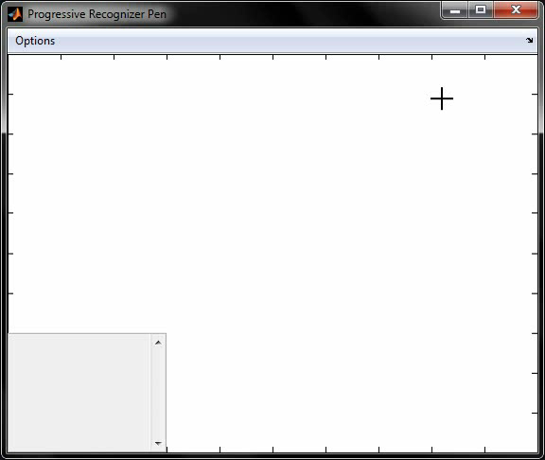

Slide 38

Future Work
Handle to the delayed strokes
Handle multiple strokes letters
Develop a word completion system
Holistic approach based recognizer
Standardize and publish the segmented version of the ADAB Database

Slide 39
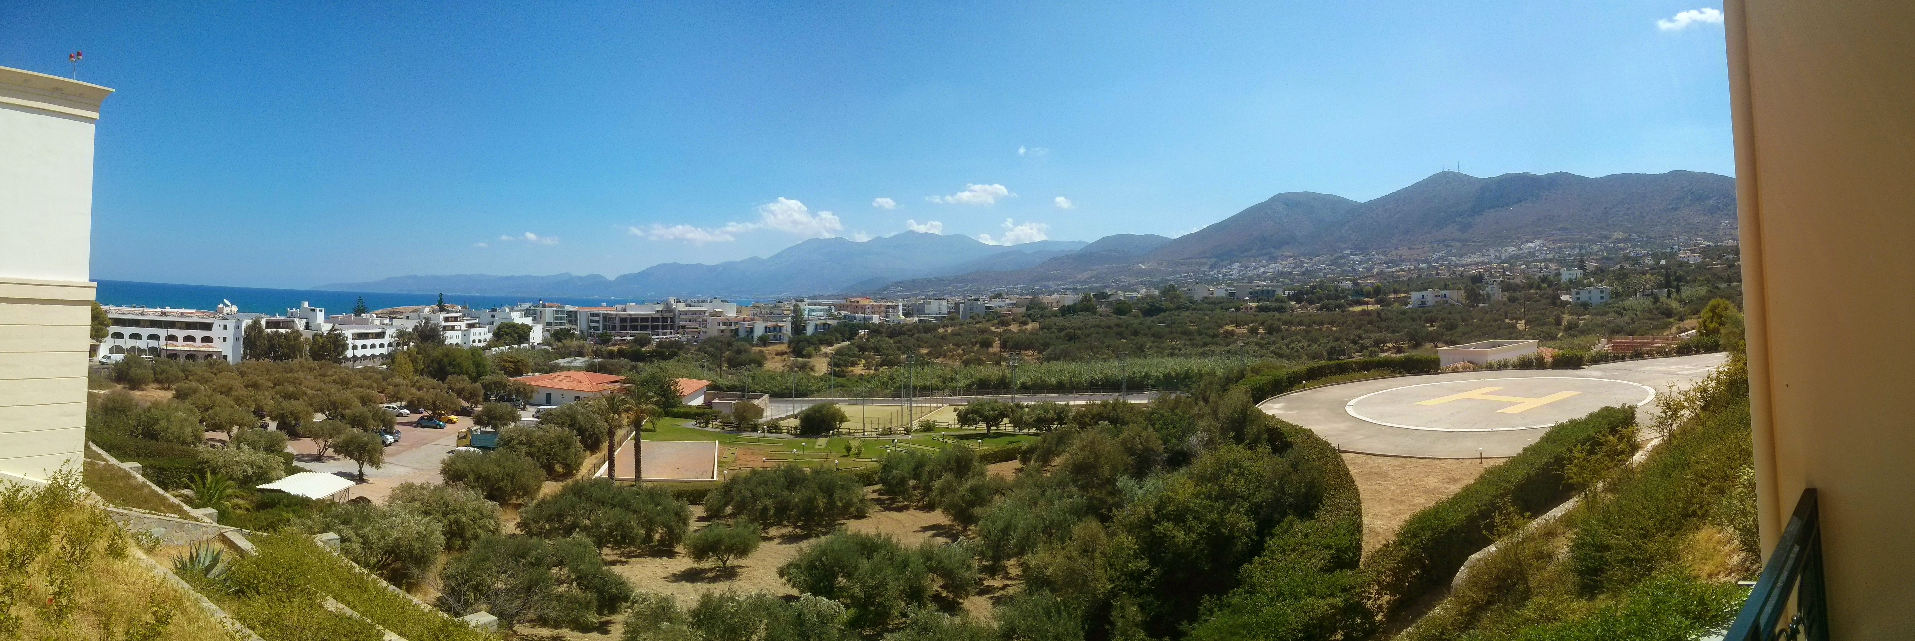
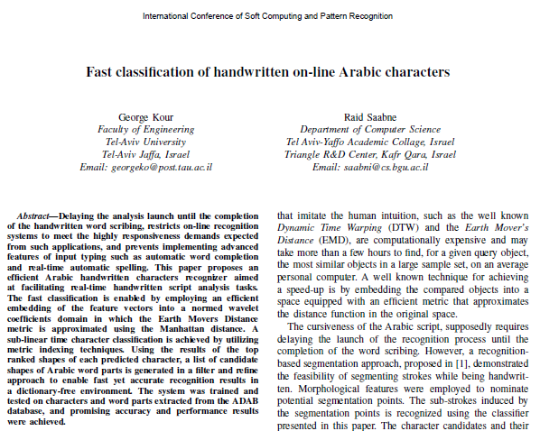
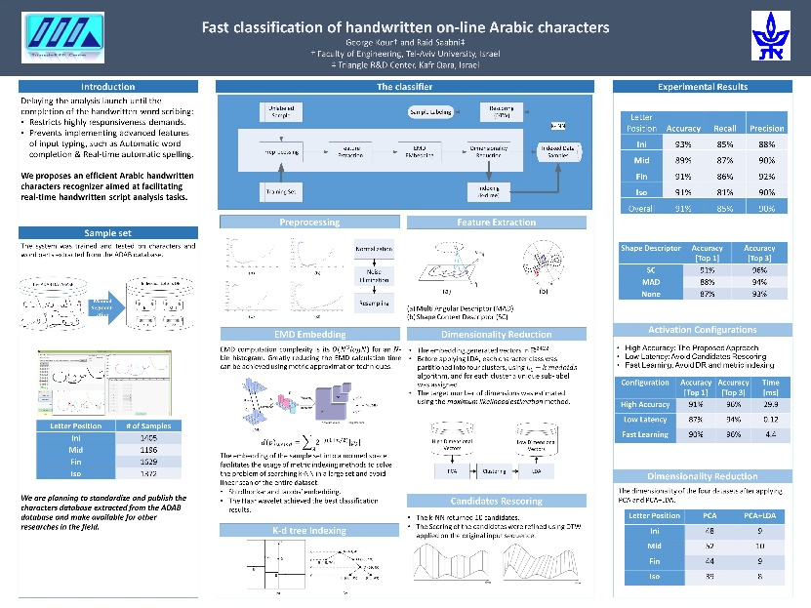
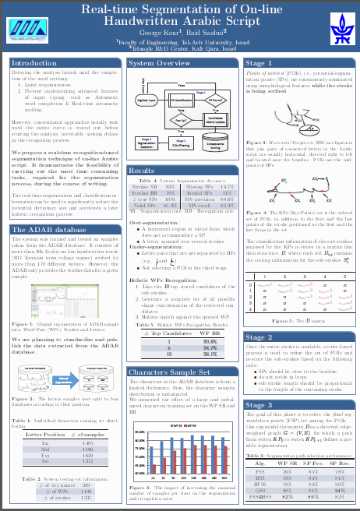
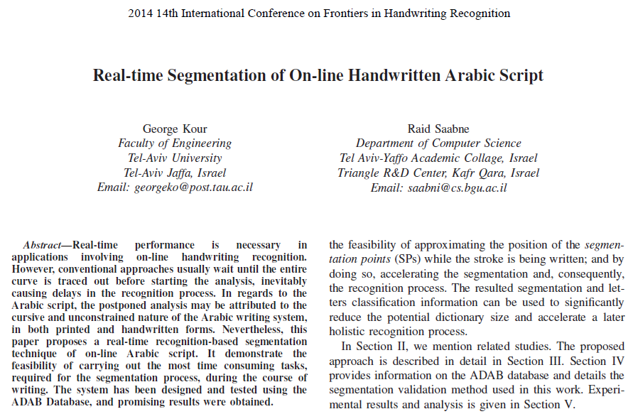
Thank You!

Slide 40
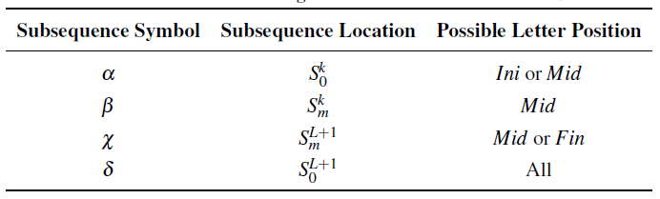


Sub-Stroke Position
Using the relative location of the sub-stroke in the stroke, we restricted the classification process to search for similar samples feasible position databases.
A mapping between the subsequence types and the possible letter positions. $S$ denotes a stroke containing $L$ POIs where $m>0$and $k<L+1$.

Slide 41
Segmentation Selection Graph

Slide 42

Segmentation Selection Algorithms Performance

Slide 43



Preprocessing (1)
Given a stroke $S={\left\{\left(x_{i},y_{i} \right)\right\}}_{i=1}^{n}$
Normalization
Uniform size bound box surrounding the pattern.
Translating the sequence so that the sequence’s center of gravity is located in the origin point.
Noise elimination using the Douglas-Peucker algorithm.
Tolerance Parameter $ε=\frac{1}{75}$.

Slide 44


Preprocessing (2)
Re-sampling
$f_{x}\left(d\right) and f_{y}\left(d\right)$ are the quadratic piecewise interpolations function of ${\left\{x_{i}\right\}}_{i=1}^{n}$ and ${\left\{y_{i}\right\}}_{i=1}^{n}$, respectively.
Let $t_{i}=i\frac{L}{R}$ where $L$ is the arc-length of the pattern and $L$ is the resampling parameter
$$\hat{S}={\left\{\left(f_{x}\left(t_{i}\right),f_{y}\left(t_{i}\right)\right)\right\}}_{i=1}^{R}$$

Slide 45
Activation Configuration
High Accuracy: The Proposed Approach
Low Latency: Avoid Candidates Rescoring
Fast Learning: Avoid DR and metric indexing
Configuration | Accuracy [Top 1] | Accuracy [Top 3] | Time [ms]
High Accuracy | 91% | 96% | 29.9
Low Latency | 87% | 94% | 0.12
Fast Learning | 90% | 96% | 4.4

Slide 46

Sample set
We are planning to standardize and publish the characters database extracted from the ADAB database and make available for other researches in the field.
Manual Segmentation

